Slide 1
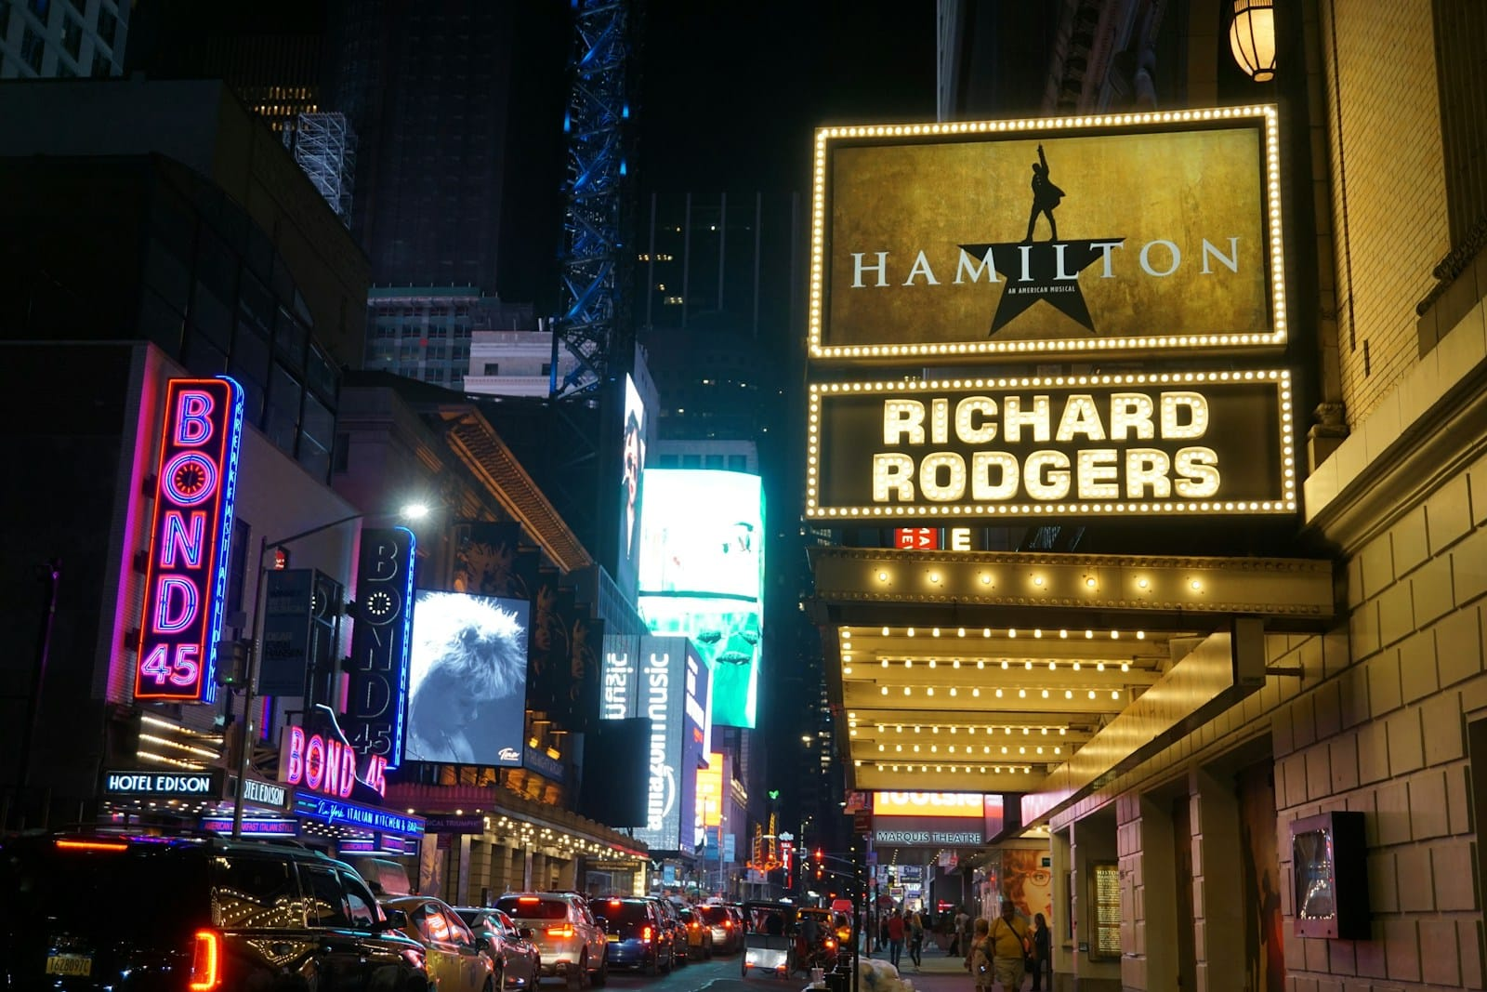
Broadway Exploratory Data Analysis
Brad Putz
Data Analytics Feb 2025

Slide 2

The Problem
Theaters across the world have been greatly affected by the pandemic and have yet to return to a pre-pandemic existence.
The issue is that the forced closure of theaters, particularly Broadway, have caused the theater going public to get out of the habit of seeing shows on a regular basis.
Do stakeholders in the industry understand the scope and the numbers behind the issue?
Are some theaters compensating too much for lower attendance by artificially raising prices, therefore making theater less accessible and stunting future growth?
What opportunities exist to reform the habit and bolster habit retention?

Slide 3

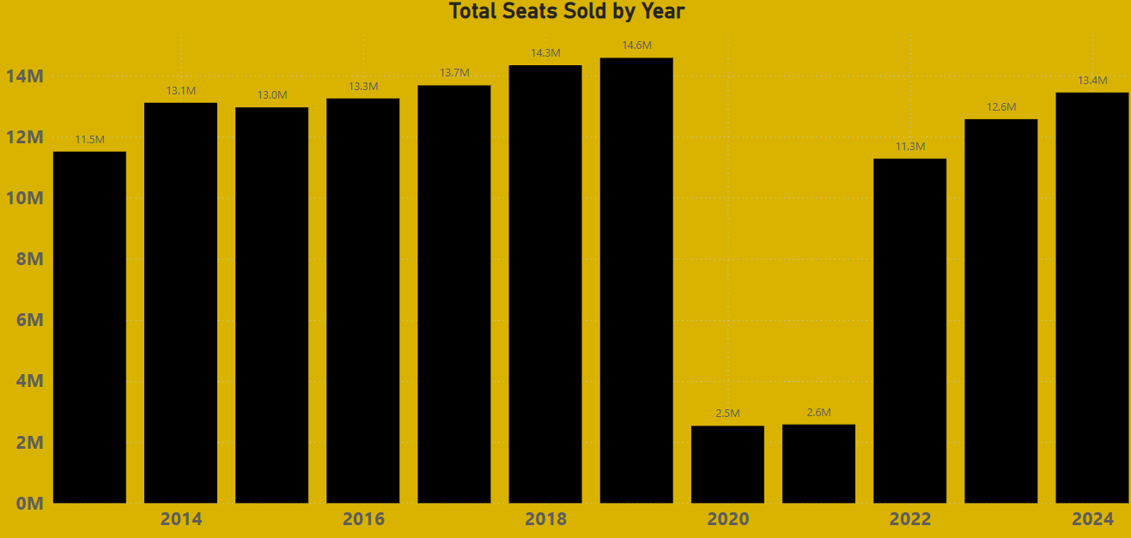
The scope of the problem
While some industries have recovered, others such as theater have yet to fully return to their former glory.
Broadway was seeing year over year growth but has yet to return to the sales volume it experienced over 10 years ago.

Slide 4
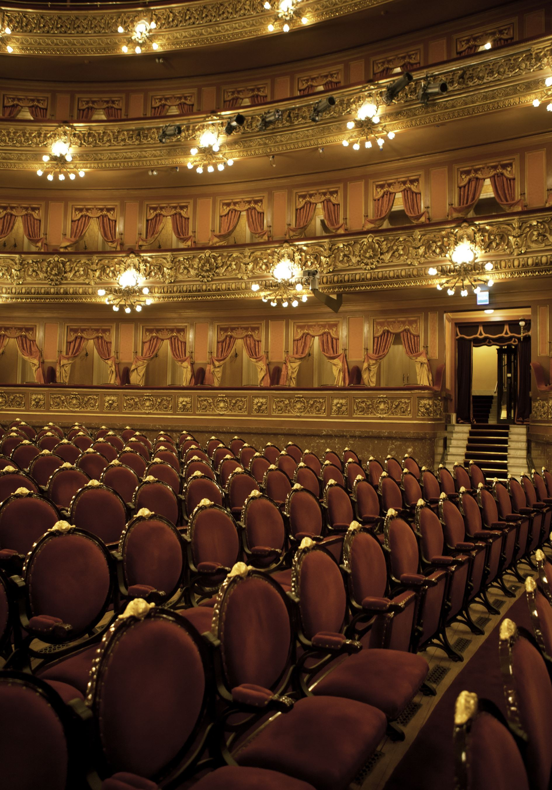
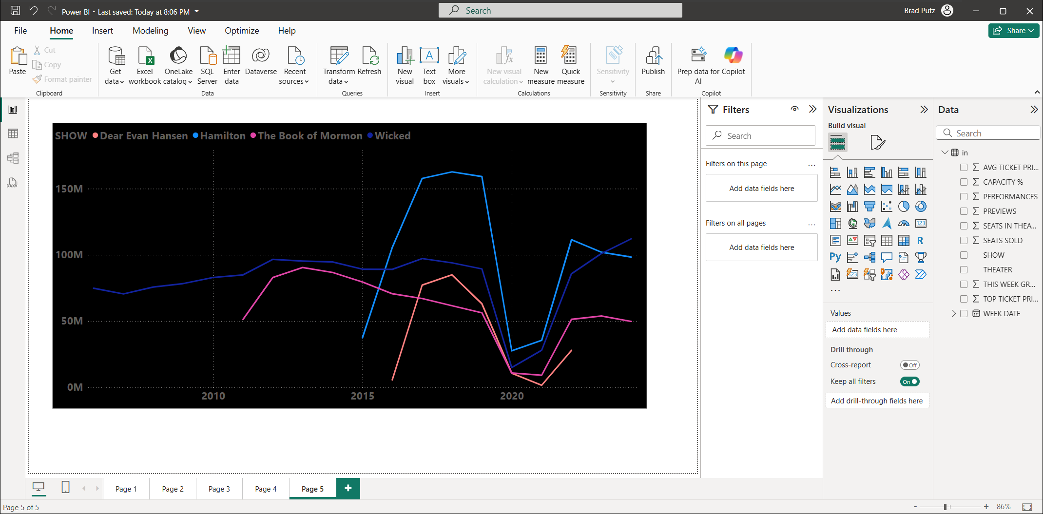

Affect on Highest Grossing Shows
Although ‘Wicked’ has enjoyed a resurgence due to a Hollywood movie release, other top grossing shows on Broadway have closed or are struggling to return to their previous highs.
‘Dear Evan Hansen’ for example experienced soft ticket sales and never recovered, eventually being forced to close.

Slide 5
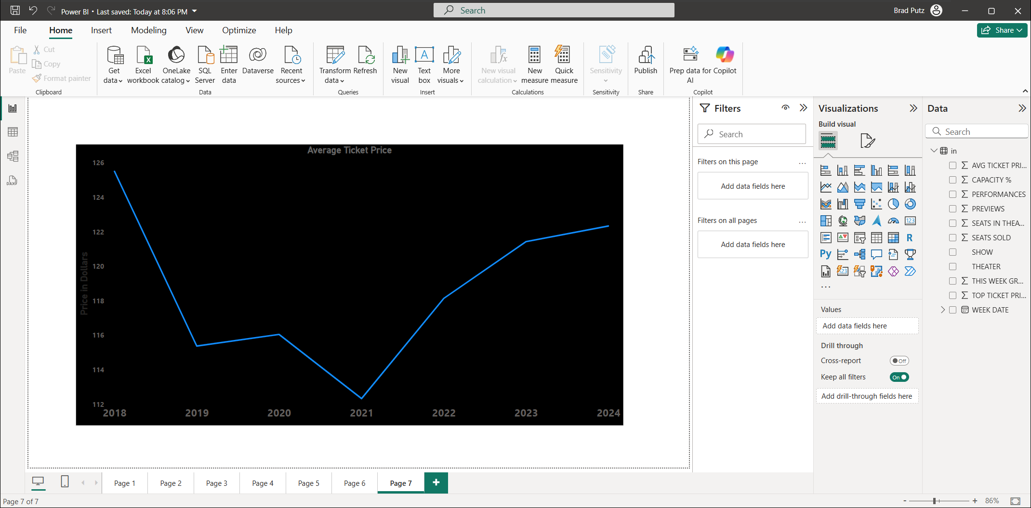
Zooming In : Affect on Ticket Prices
Even though ticket prices are back on the rise, they are still far off from the amount seen in 2018.
Furthermore, when adjusting for inflation, the issue is even bigger.
An average ticket price of $125 in 2018 equates to roughly $160 today.

Slide 6

Metrics to look at for growth
What data can theaters look at to help understand areas for growth improvement?
Based on a detailed exploratory analysis of the data, trends and correlations have been uncovered in the following areas:
The number of previews a theater offers compared to the resulting overall sales.
Average ticket pricing and how it affects the number of seats a theater fills per show.
The power of “brand recognition” and the opportunities it creates.

Slide 7
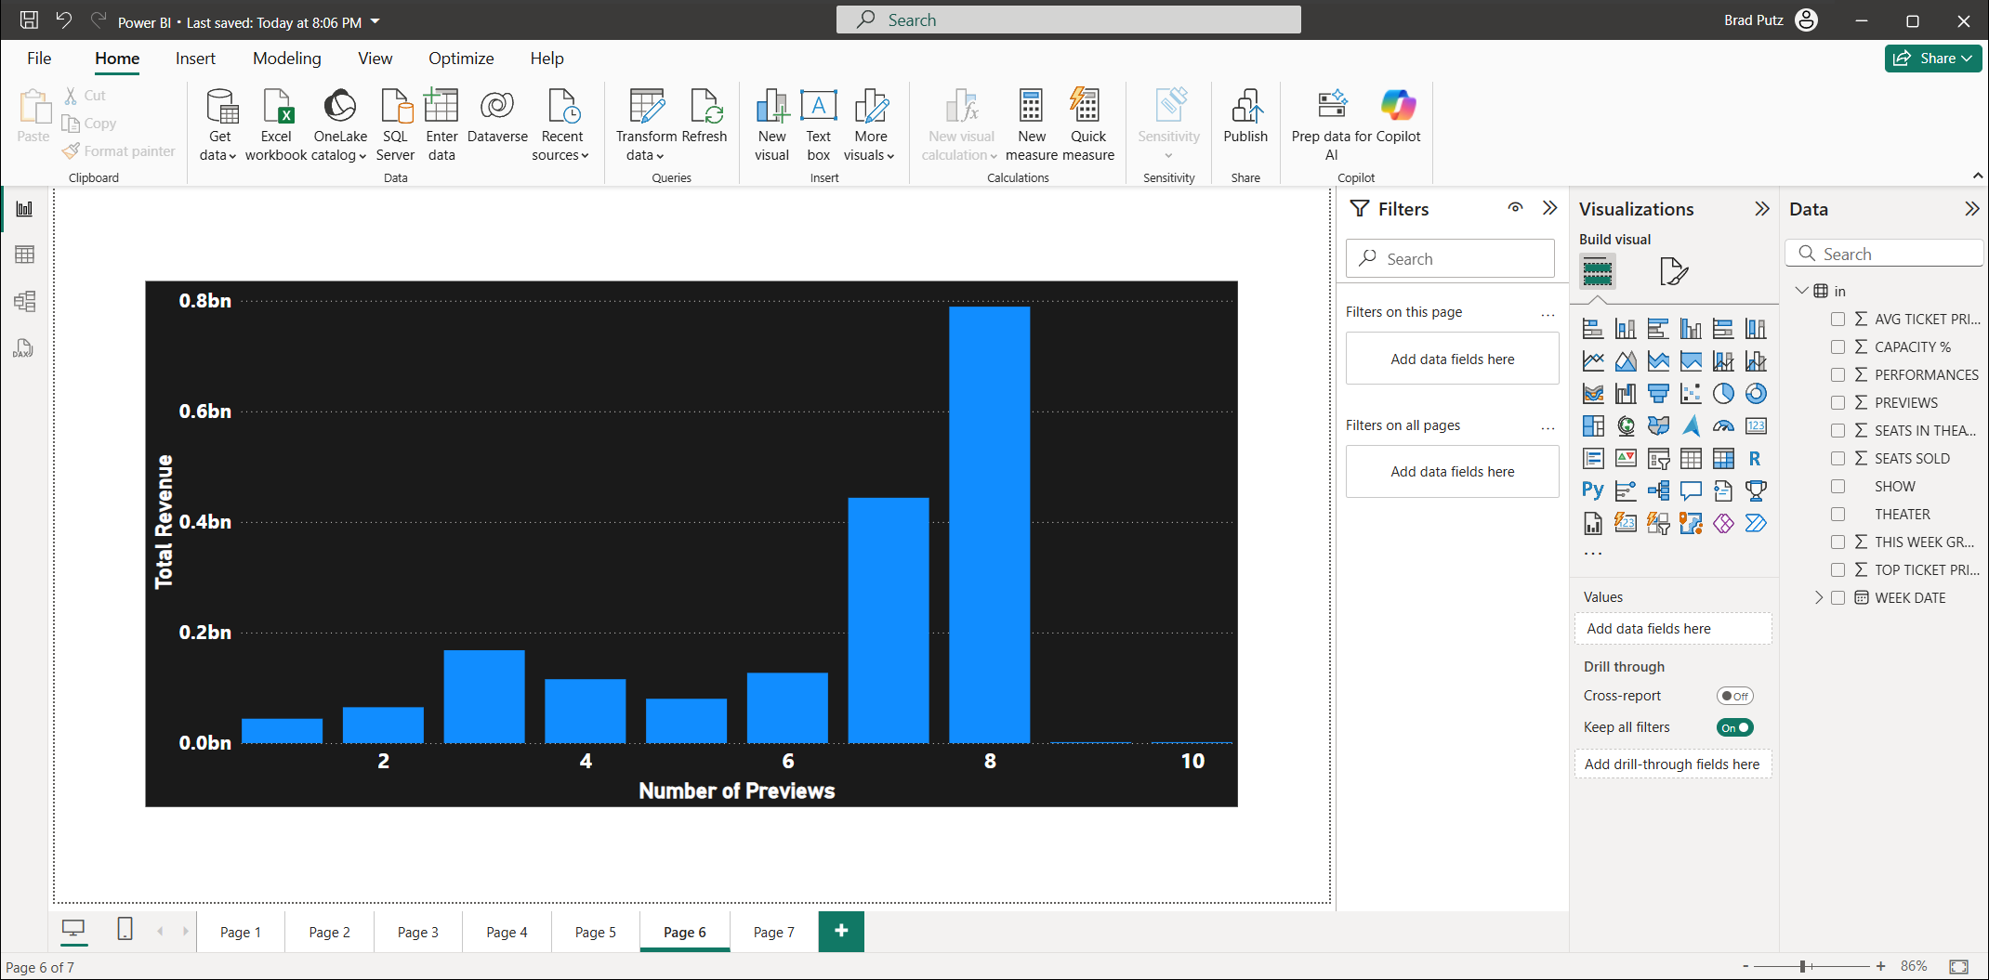
Show Preview Data
Preview: A public performance(s) held prior to opening night to allow the creative team opportunities to identify and address issues with a show before it is fully reviewed.
Diving into the data, it is clear that 8 previews of a show return the greatest promise of future revenue.
It follows logically that the more ‘practice’ a show has prior to its full release, the better chance it has of becoming a success.
While this may cost a theater more up front, the resulting future profits far outweigh the increased initial investment.
Supported by the data, 8 show previews should be regarded as an industry standard.

Slide 8
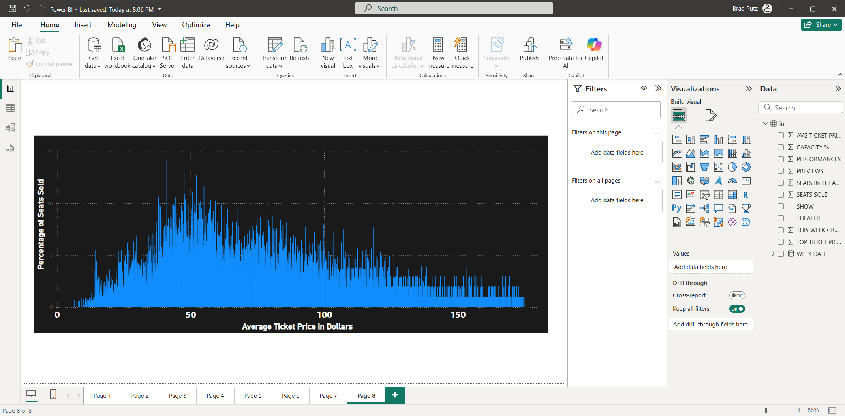
Average Ticket Pricing
While seats near the front of the theater will always be more expensive, this data shows that more affordable ticket pricing makes theater more accessible and fills seats.
More affordable ticket pricing may not be as attractive to stakeholders in the immediate future, but drawing in greater numbers and selling full capacity theaters will cause growth over time.
Broadway theaters have a trend to charge higher and higher prices, but does this hurt overall future growth?
Refer to Dashboard

Slide 9
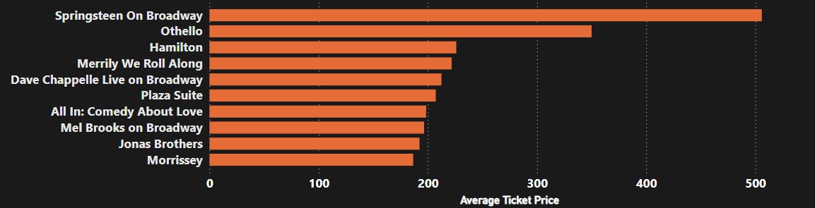
Brand Recognition
What gets patrons in the door? Names they know.
The data shows that a production with a celebrity name attached to it can command ticket prices that far outperform the rest.
Othello : Denzel Washington
Merrily We Roll Along : Daniel Radcliffe
Plaza Suite : Matthew Broderick & Sarah Jessica Parker
These shows draw huge numbers to the theater industry and provide opportunities to reach new theater subscribers.

Slide 10
Actionable Insights
Based on an analysis of the data, the following steps can be taken by Broadway theaters to encourage greater growth over time:
Adjust the number of previews per show to allow for the greatest future ticket sales. The data shows that the most beneficial number of preview is 8.
Consider a more balanced approach to ticket pricing to ensure maximum profits but to also maximize the number of seats sold. This will make theater more accessible to the public in general which will cause industry growth over time.
Price Elasticity of Demand = Percentage Change in Quantity Demanded
Percentage Change in Price
Live theater DOES have an elasticity of demand, affecting overall growth
Use shows with high “brand recognition” as an opportunity for more touch points with potential new theater goers and subscribers.
Email drip campaigns are not enough; we are bombarded with hundreds of emails a day.
Seek new opportunities such as interactive methods for a younger audience used to immediacy.
Easily accessible QR codes leading to material for a more tech savvy audience.
Collabs with top social media influencers
Integrate tech like VR into theaters for promos

Slide 11

Fin
The theater industry, lead by Broadway, is struggling to return to its former self, but data-backed tangible takeaways exist to encourage future growth.
Using data to understand the scope of the problem and to find opportunities that exist will help guide this industry back into the limelight it deserves to bask in.

